Slide 1

Unit-03 Properties of CSS
Web Designing - II (WD-II) (2304CS202)
CO3 : At the end of this chapter, students will be able to,
apply CSS properties for web page design.
Prof. Dharmikkumar G. Aghera
Computer Application Department
dharmikkumar.aghera@darshan.ac.in
9898205621

Slide 2

Outline
The Box Model
Text Properties
Font Properties
Background Properties
Border Properties
Link
Float Properties
CSS Positioning
CSS Layer
Looping

Slide 3
The Box Model
Section - 1

Slide 4
The Box Model
All HTML elements can be considered as boxes. In CSS, the term "box model" is used when talking about design and layout.
The CSS box model is essentially a box that wraps around HTML elements, and it consists of: margins, borders, padding and the actual content.
The box model allows us to place a border around elements and space elements in relation to other elements.

Slide 5
The Box Model
The image below illustrates the box model:
Margin
Border
Padding
Content

Slide 6
The Box Model
margin-top
border-top
padding-top
Content
border-right
padding-left
margin-right
margin-left
padding-right
border-left
padding-bottom
border-bottom
margin-bottom

Slide 7
CSS Text Property
Section - 2

Slide 8
CSS Text Property
While CSS Font covers most of the traditional ways to format your text, CSS Text allows you to control the spacing, decoration, and alignment of your text.
Text Decoration (text-decoration)
Text Indent (text-indent)
Text Align (text-align)
Text Transform (text-transform)
White Space (white-space)
Word Spacing (word-spacing)
Letter Spacing (letter-spacing)
Line Height (line-height)
Property Name

Slide 9
CSS Text Property
Text Decoration
The text-decoration property is used to set or remove decorations from text.
The text-decoration property is mostly used to remove underlines from links for design purposes.
Text Indent
The text-indentation property is used to specify the indentation of the first line of a text.
Text Align
The text-align property is used to set the horizontal alignment of a text.
h4{
text-decoration : line-through;
text-decoration : overline;
text-decoration : underline;
text-decoration : none;
}
h4{
text-indent : 20px;
text-indent : 30%;
}
h4{
text-align : right;
text-align : justify;
text-align : left;
text-align : center;
}

Slide 10
CSS Text Property
Text Transform
The text-transform property is used to specify uppercase and lowercase letters in a text.
White Space
The white-space attribute allows you to prevent text from wrapping until you place a break <br /> into your text.
Word Spacing
With the CSS attribute word-spacing you are able to specify the exact value of the spacing between your words. Word-spacing should be defined with exact values.
h4{
text-transform : capitalize;
text-transform : uppercase;
text-transform : lowercase;
}
h4{
white-space : nowrap;
}
h4{
word-spacing : 10px;
}

Slide 11
CSS Text Property
Letter Spacing
With the CSS attribute letter-spacing you are able to specify the exact value of the spacing between your letters. Letter-spacing should be defined with exact values.
Line Height
The line-height attribute will set the height of the line in the page.
h4{
letter-spacing : 3px;
}
h4{
line-height : 10px;
}

Slide 12
CSS Font Property
Section - 3

Slide 13
CSS Font
CSS font properties define the font family, boldness, size, and the style of a text.
Font Color (color)
Font Family (font-family)
Font Size (font-size)
Font Style (font-style)
Font Weight (font-weight)
Font Variant (font-variant)
Property Name

Slide 14
CSS Font
h4{
color : red;
}
Font Color
Set the text-color for different elements
Font Family
The font family of a text is set with the font-family property.
Font Size
The font-size property sets the size of the text.
font-size : 120%
font-size : 10px;
font-size : x-large;
h4{
font-family : sans-serif;
}
h4{
font-size: 120%;
font-size : 10px;
font-size : small;
font-size : smaller;
font-size : x-small;
font-size : xx-small;
font-size : large;
font-size : larger;
font-size : x-large;
font-size : xx-large;
font-size : medium;
}

Slide 15
CSS Font
Font Style
The font-style property is mostly used to specify italic text.
Font Weight
The font-weight property sets how thick or thin characters in text should be displayed.
Font Variant
The font-variant property specifies whether or not a text should be displayed in a small-caps font.
font-variant : small-caps;
h4{
font-style: italic ;
}
h4{
font-weight : 300;
font-weight : bolder;
font-weight : lighter;
}
h4{
font-variant: small-caps;
}

Slide 16
Background Properties
Section - 4

Slide 17
Background Property
Background Color (background-color)
Background Image (background-image)
Background Image Repeat (background-repeat)
Fixed Background Image (background-attachment)
Background Image Positioning (background-position)
Property Name

Slide 18
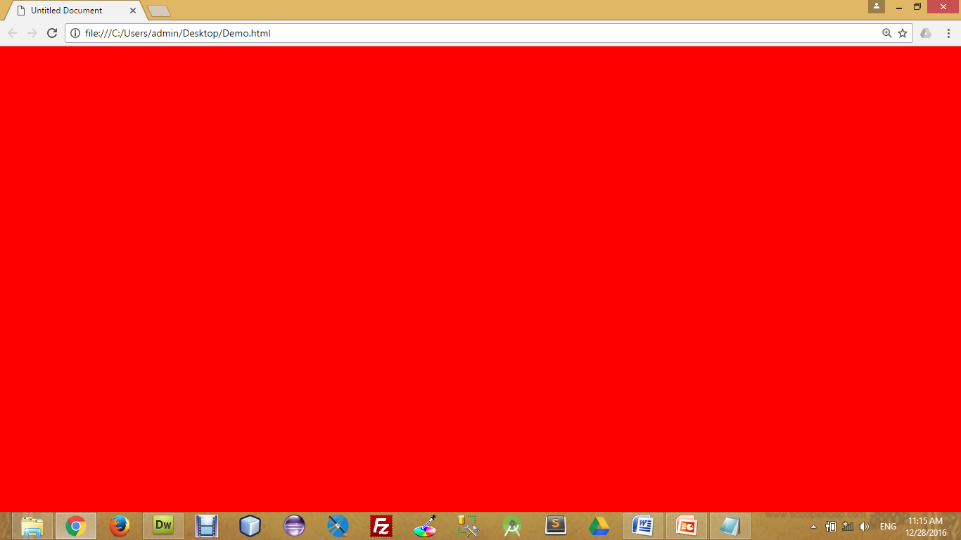
Background Color
The background-color property specifies the background color of an element.
The background color of a page is defined in the body selector:
Below is example of CSS backgrounds
test.css
body
{
background-color : red;
background-color : #FF0000;
background-color : rgb(255,0,0);
}

Slide 19

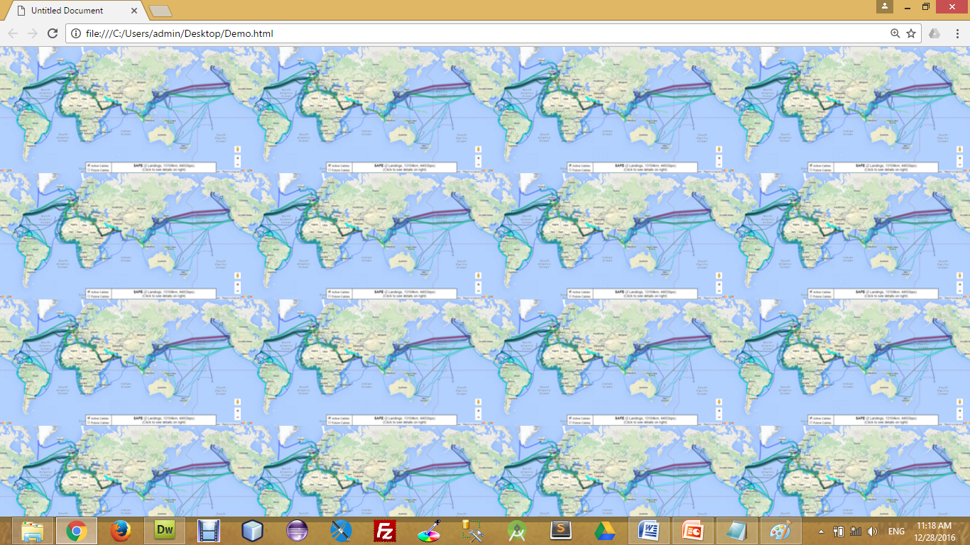
Background Image
The background-image property specifies an image to use as the background of an element.
For Example,
test.css
body
{
background-image : url(‘pathToImage.jpg’);
}

Slide 20
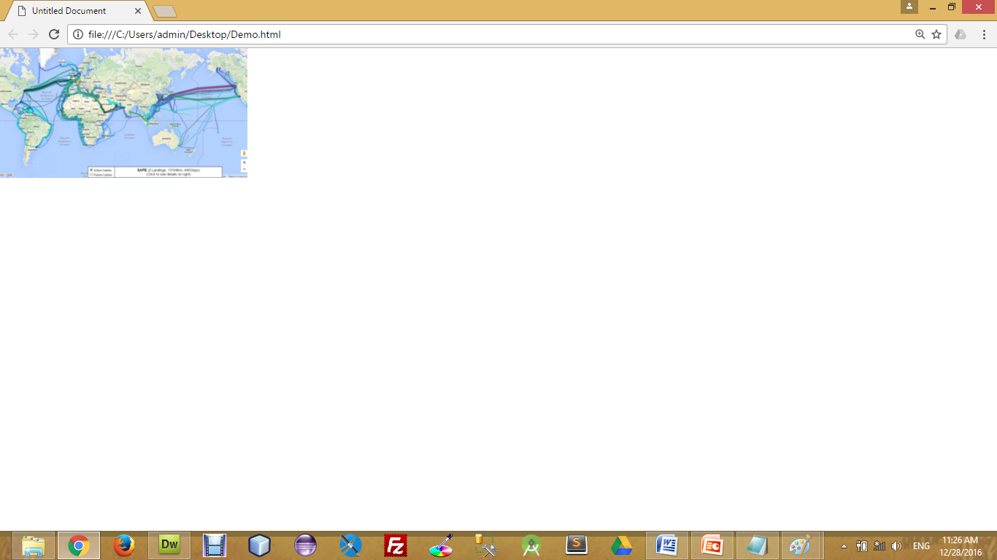
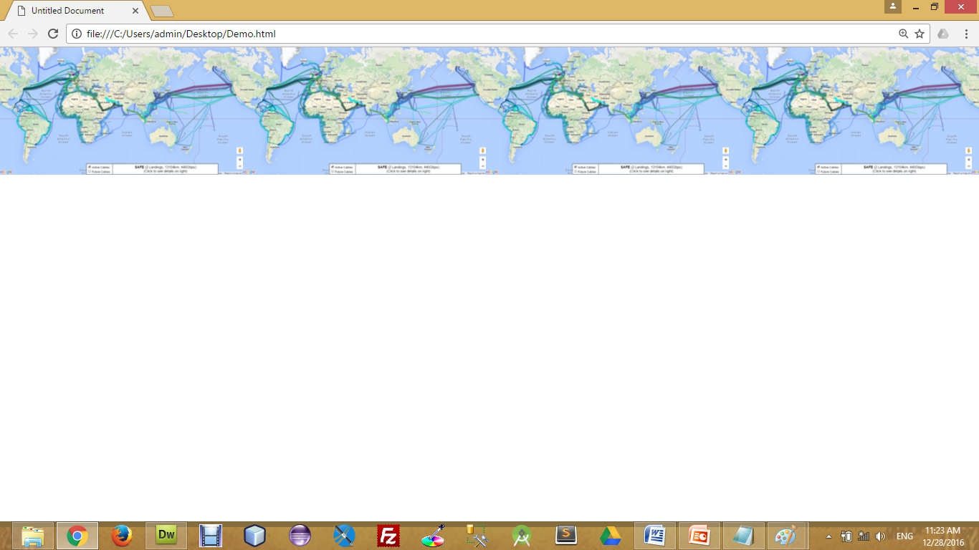
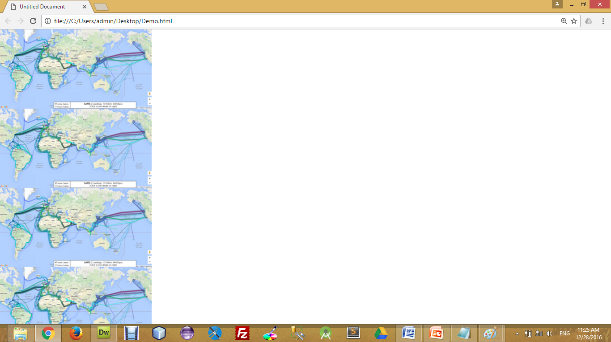
Background Image Repeat
You can have a background image repeat vertically (y-axis), horizontally (x-axis), in both directions, or in neither direction.
test.css
body
{
background-image : url(‘pathToImage.jpg’);
background-repeat : repeat;
background-repeat : repeat-x;
background-repeat : repeat-y;
background-repeat : no-repeat;
}

Slide 21
Fixed Background Image
The background-attachment property sets whether a background image is fixed or scrolls with the rest of the page.
For Example,
test.css
body
{
background-image : url(‘pathToImage.jpg’);
background-repeat : no-repeat;
background-attachment : fixed;
}

Slide 22
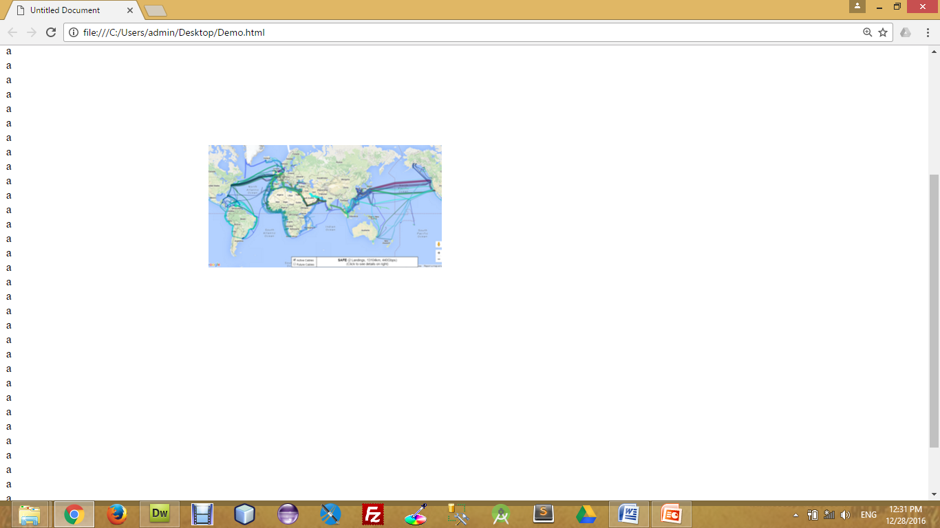
Background Image Positioning
The background-position property sets the starting position of a background image.
test.css
body
{
background-image : url(‘pathToImage.jpg’);
background-repeat : no-repeat;
background-position: 20px 10px;
background-position: 30%30%;
background-position: top center;
}

Slide 23
CSS Padding
Section - 5

Slide 24
CSS Padding
The CSS padding properties define the space between the element border and the element content.
The top, right, bottom and left padding can be changed independently using separate properties.
A shorthand padding property can also be used, to change all padding at once.
h4{
padding : 10px;
}
h4{
padding-top : 10px;
padding-right : 20px;
padding-bottom : 30 px;
padding-left : 40 px;
}
h4{
padding : 10px 20px 30px 40px;
}

Slide 25
CSS Border
Section - 5

Slide 26
CSS Border
The CSS border properties allow you to specify the style and color of an element's border.
Border Style Types
The border-style property specifies what kind of border to display.
Border Width
The border-width property is used to set the width of the border.
Border Color
The border-color property is used to set the color of the border.
Border colors can be any color defined by RGB, hexadecimal, or key terms. Below is an example of each of these types.
The top, right, bottom and left border can be changed independently using separate properties.
h4{
border : 1px solid red;
}
h4{
border-style : solid;
border-style : dotted;
border-style : double;
}
h4{
border-width : 7px;
}
h4{
border-color : red;
}
h4{
border-top : 1px solid red;
}

Slide 27
CSS Margin
Section - 5

Slide 28
CSS Margin
The CSS margin properties define the space around elements
The top, right, bottom and left margin can be changed independently using separate properties.
A shorthand margin property can also be used, to change all margins at once.
h4{
margin: 10px;
}
h4{
margin -top : 10px;
margin -right : 20px;
margin -bottom : 30 px;
margin -left : 40 px;
}
h4{
margin : 10px 20px 30px 40px;
}

Slide 29
Styling list
Section - 6

Slide 30
Styling List
ul{
list-style-type: square;
list-style-type: circle;
list-style-type: none;
}
ol {
list-style-type: upper-roman;
list-style-type: lower-alpha;
}
List Item Markers
Use an image as a List Item Marker
List Item Markers position
ul{
list-style-image: url(‘abc.gif');
}
ul{
list-style-position: outside;
list-style-position: inside;
}

Slide 31
Style Images
We can use many properties with Images like,
opacity
border-radius
margin-left, margin-right to be auto and display to be block (to make it aligned center)
max-width to be 100% and height to be auto (to make it responsive)
filter : blur, brightness, contrast, drop-shadow, grayscale etc…
etc…

Slide 32
Float Properties
Section - 7

Slide 33
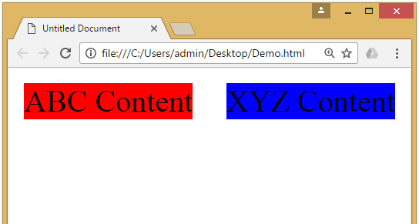
CSS Float Property
The CSS float property defines that an element should be taken out of the normal flow of the document and placed along the left or right side of its containing block.
Text and inline elements will then wrap around this element.
HTML
<div id="division1">
ABC Content
</div>
<div id="division2">
XYZ Content
</div>
CSS
#division1{
background-color : red;
float : left;
width: 40%;
}
#division2{
background-color : blue;
float : right;
width: 40%;
}

Slide 34
CSS Positioning
Section - 8

Slide 35
CSS Positioning
Absolute Positioning
With absolute positioning, you define the exact pixel value where the specified HTML element will appear.
The point of origin is the top-left of the browser's viewable area, so be sure you are measuring from that point.
Relative Positioning
Relative positioning changes the position of the HTML element relative to where it normally appears
h1{
position : absolute;
left : 50px;
top : 100px;
}
h1{
position : relative;
left : 50px;
top : 100px;
}

Slide 36
CSS Positioning
Fixed Positioning
The element is positioned relative to the browser window, in fixed position, element will be in the same place even we scroll the screen.
Sticky Positioning
An element with position : sticky; is positioned based on the user's scroll position.
A sticky element toggles between relative and fixed, depending on the scroll position.
h1{
position : fixed;
top : 50px;
left : 100px;
}
h1{
position : sticky;
top : 0px;
}

Slide 37
CSS Layers
Section - 9

Slide 38

CSS Layers
CSS allows you to control which item will appear on top with the use of layers.
In CSS, each element is given a priority.
If there are two overlapping CSS positioned elements, the element with the higher priority will appear on top of the other.
To manually define a priority, set the z-index value. The larger the value, the higher the priority the element will have.
CSS
#division1{
position : absolute;
height : 100px;
width : 100px;
left : 100px;
top : 150px;
background-color : red;
z-index : 5;
}
#division2{
position : absolute;
height : 200px;
width : 200px;
left : 50px;
top : 100px;
background-color : blue;
z-index : 2;
}
HTML
<div id="division1">
</div>
<div id="division2">
</div>

Slide 39
Web Designing - II (WD-II) (2304CS202)
Prof. Dharmikkumar G. Aghera
Computer Application Department
dharmikkumar.aghera@darshan.ac.in
9898205621

